Slide 1

YOUR SOLUTION IN FLOW CONTROL
We offer products and systems to control all kind of media and specializing in the control equipment for Oil & Gas area.
Our staff & OEM partners are your best solution in flow control.

Slide 2

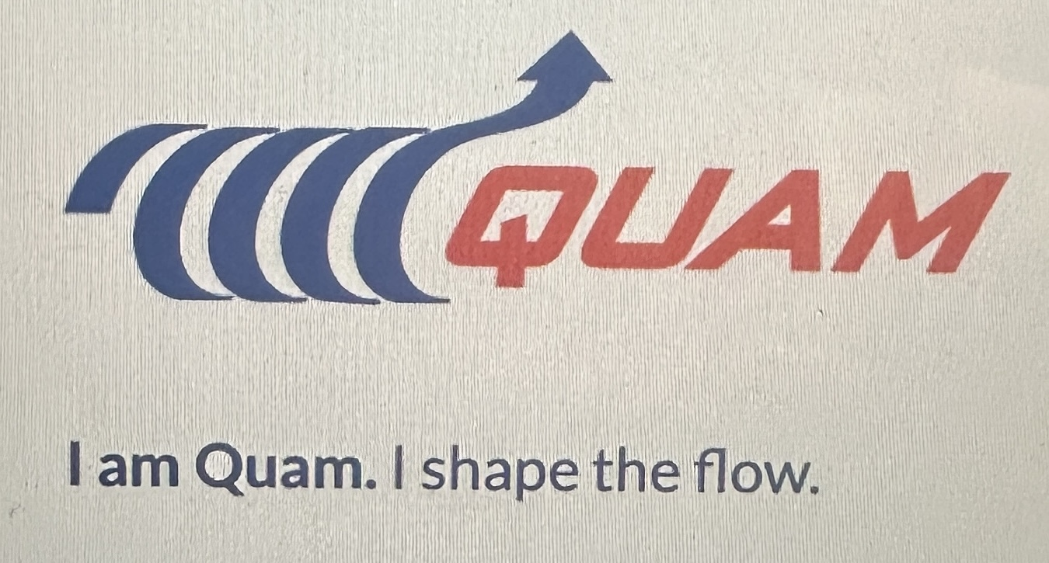


WHO WE ARE?
MS Tekhnomarket LLP was established in 2006 as a supply chain and engineering company specializing in Oil & Gas equipment and flow control solutions.
Today, we operate as a trade house and a leading global distributor of industrial products, tools, services, and integrated supply solutions, supporting major Oil & Gas and energy projects in Kazakhstan.
Over the years, MS Tekhnomarket has built a strong reputation as a professional and reliable partner for both customers and international OEM manufacturers.
We are an official authorized partner and distributor of leading international brands, including:
SAMSON Group (Germany)
QUAM Controls S.R.L
AUDCO ITALIANA (All types of valves with fast delivery option)
JH Valve (China)
Any brand ( OEM) as per client request
other equipment spare parts and tools
for the Oil & Gas and energy market of Kazakhstan.
Our key strength is our highly qualified local team, providing immediate technical and commercial support. Our engineers are trained by OEM partners and maintain direct communication with OEM engineering teams, ensuring fast response and optimal technical solutions.
Head Office: Almaty
Regional branches: Aksai, Atyrau, Aktau

Slide 3
WHERE WE ARE GOING ?
GLOBAL
FLOW CONTROL MANAGEMENT
New Valves Supply/other equipment supply
Localization of the Services incl. after maintenance service
Preventive & Predictive Maintenance
Control Valves Preservation
Valves Warehouse Management incl Spare Parts supply
Technical & Engineering Support
Our mission is to be a reliable long-term partner, providing high-level technical expertise and strong engineering capabilities to deliver optimal flow control solutions. We continuously invest in the development and training of our local team and expand our service portfolio to build strong local content capacity, with a special focus on the West Kazakhstan region, supporting our OEM partners in covering the entire Kazakhstan market. Our strategic goal is to establish a comprehensive Global Flow Control Management system and maximize localization of services and products. We differentiate ourselves through a personalized approach, deep product expertise, and strong customer focus. By working closely with our clients and applying continuous innovation, we deliver efficient and tailored solutions. Our strength lies in our ability to think “outside the box”, enabling us to develop customized solutions for complex technical challenges.

Slide 4
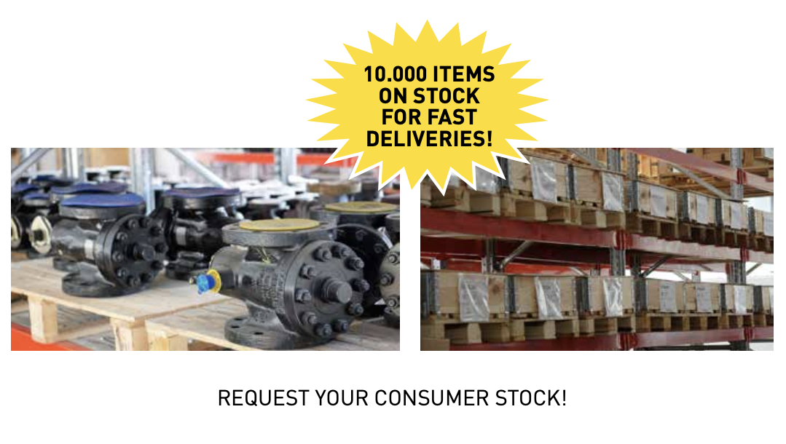
WHY MS Tekhnomarket?
Reliable Industrial Supply Partner for Kazakhstan's Oil & Gas Industry
MS Tekhnomarket LLP is a Kazakhstan-based engineering and industrial supply company delivering fast, reliable and cost-effective procurement solutions for the Oil & Gas and Energy sectors.
Today we operate as an integrated Trade House, combining global sourcing, local engineering expertise and rapid execution to support operators, EPC contractors and industrial clients.
Why customers choose us
⚡ Fast Delivery
Local inventory for selected products
Express sourcing from Europe and Asia
Reduced procurement lead times
💰 Best Value
European quality & fast delivery
Competitive pricing
Qualified Chinese manufacturers
Flexible sourcing strategy
One supplier for multiple product categories
🔧 Technical Expertise
Experienced local engineering team
OEM technical support
Valve and flow control specialists
Commercial & technical assistance

Slide 5
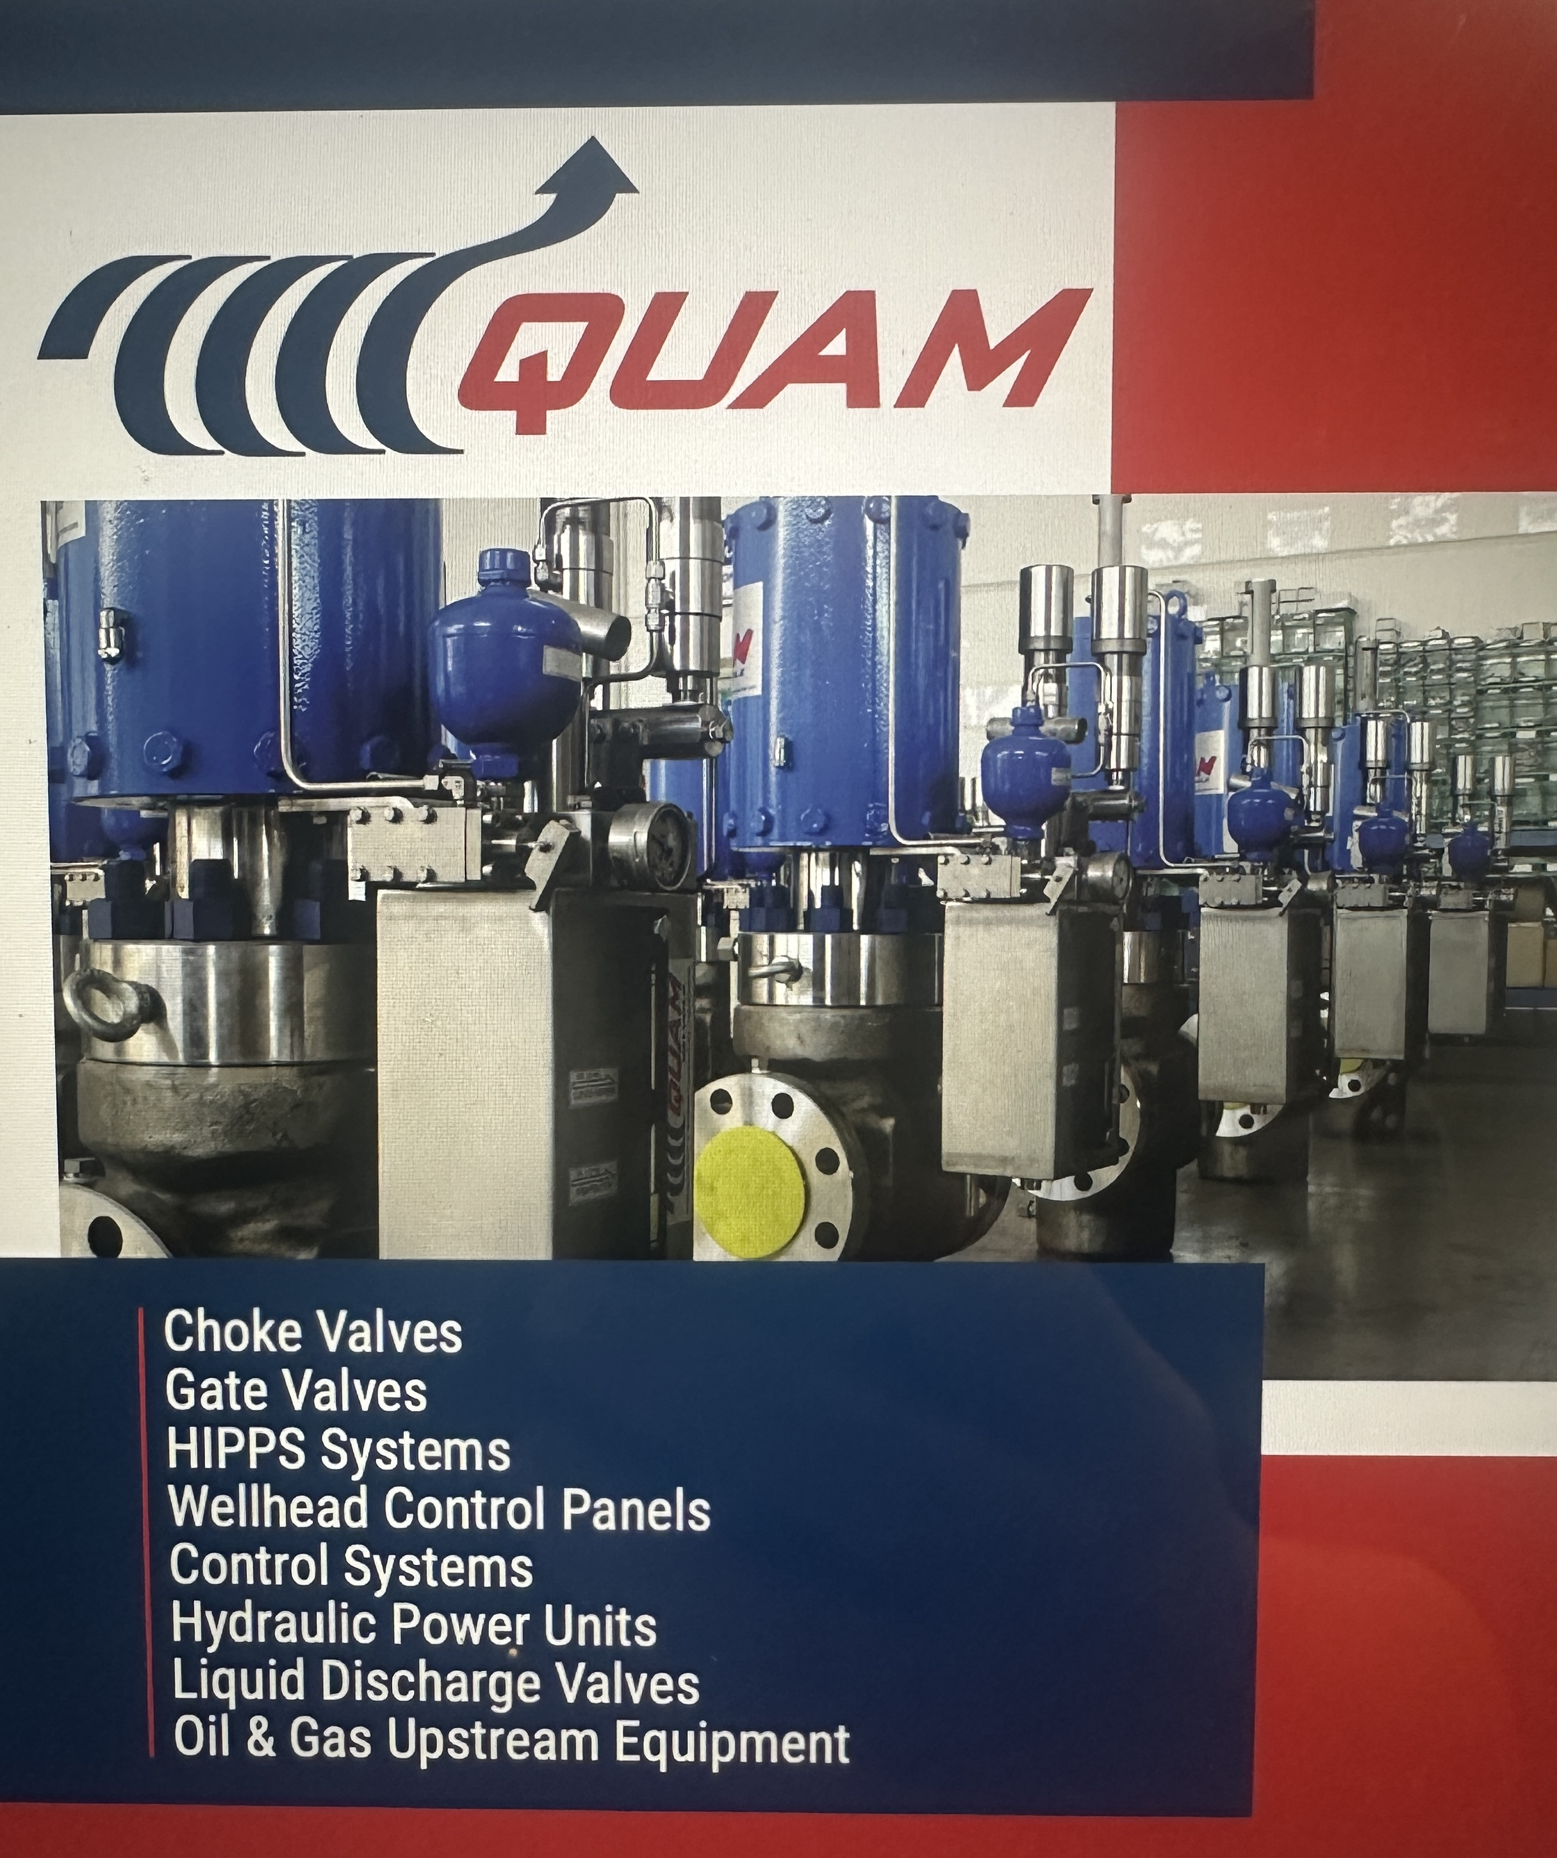
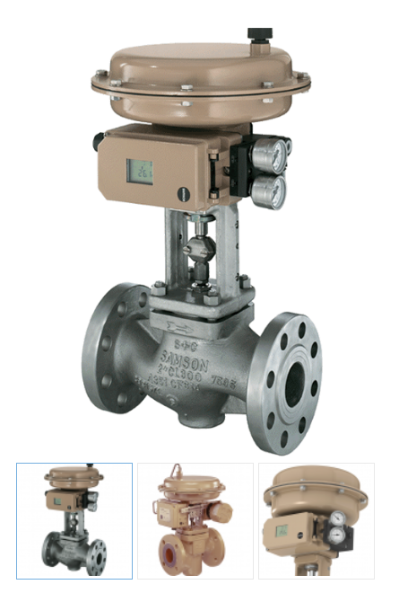

OUR EUROPEAN
MANUFACTURERS
Valves
Types: Ball, Gate, Globe, Check, Choke, Control, Axial, PSV
Wellhead/Christmas tree
Wellhead Control Panels
Size: ½’’ – 48’’ | Pressure Class: 150 – 10K
Operation: Manual, Actuated, BDV, ESD
Country of Origin: Europe, China
Spare Parts
Spare parts for all brands of valves

Slide 6
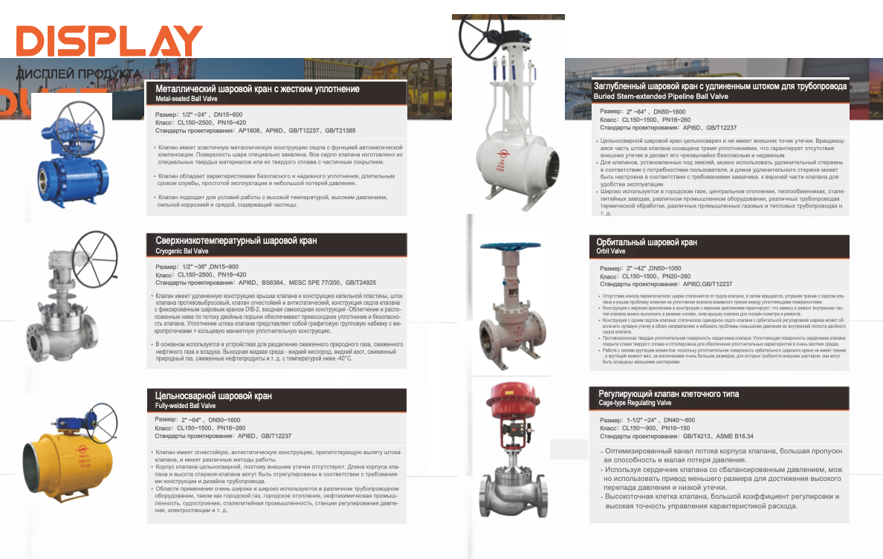
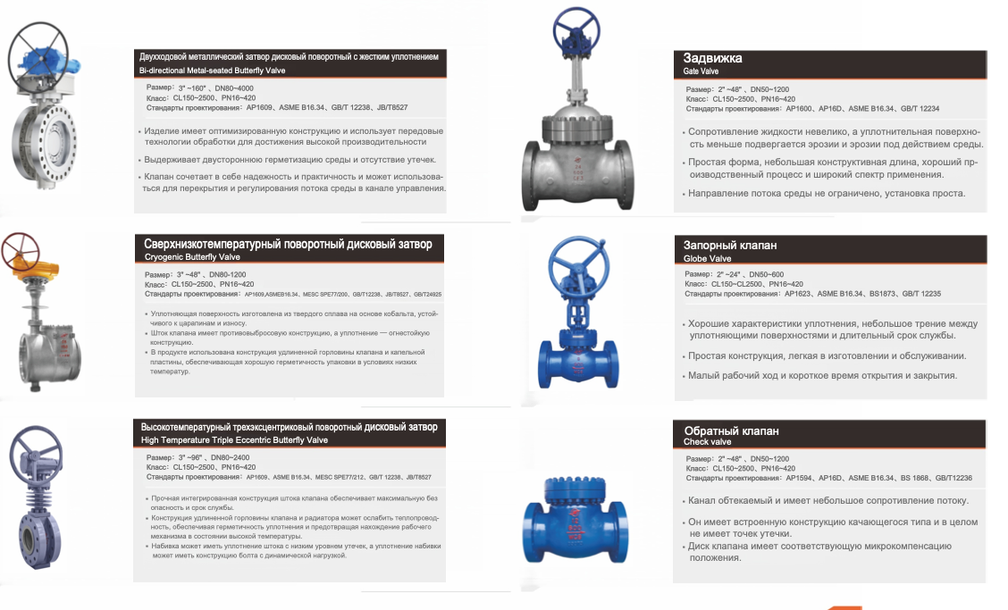
OUR QUALIFIED ASIAN MANUFACTURERS
Cost-effective solutions for demanding Oil & Gas applications.
Valves
Types: Ball, Gate, Globe, Check, Choke, Control, Axial, PSV, Butterfly Valves
Size: ½’’ – 48’’ | Pressure Class: 150 – 10K
Operation: Manual, Actuated, BDV, ESD
Country of Origin: Europe, China
Spare Parts
Spare parts for all brands of valves

Slide 7
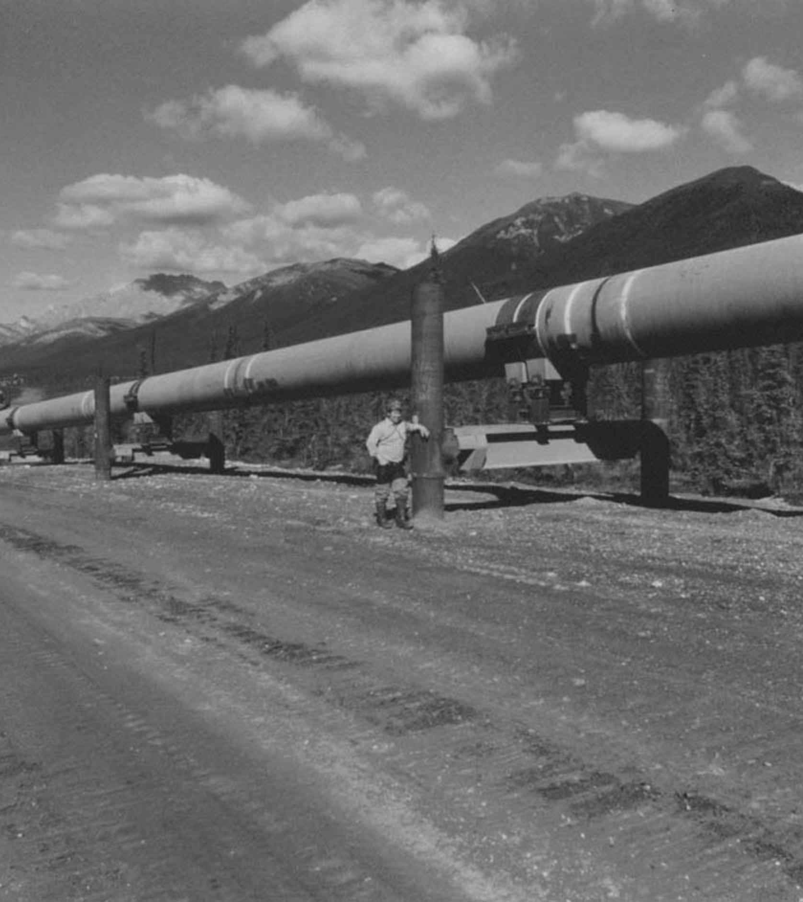
ADDITIONAL OIL & GAS EQUIPMENT
CHOKE MANIFOLDS
HIPPS
HYDRAULIC POWER UNIT
WELLHEAD CONTROL PANNELS
SPARE PARTS FOR INDUSTRIAL PRODUCTS
ISOLATION EQUIPMENT
ACTUATORS & FIRE JACKETS
PUMPS & ACCESSORIES
FITTINGS
OTHER FLOW CONTROL EQUPMENT

Slide 8
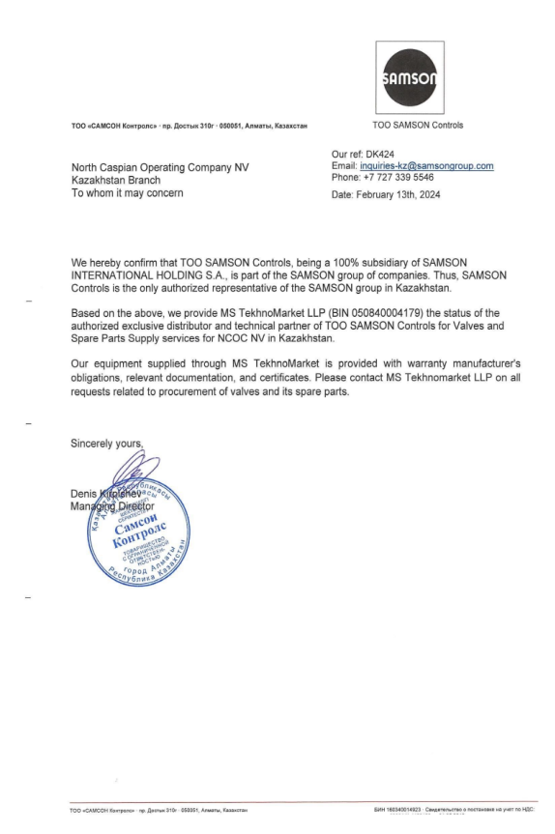
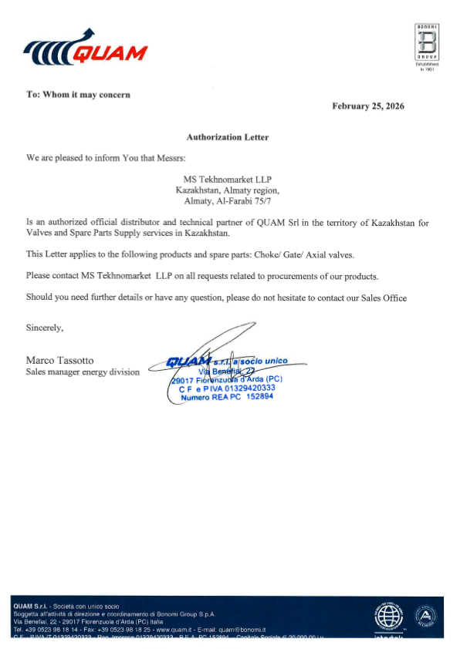
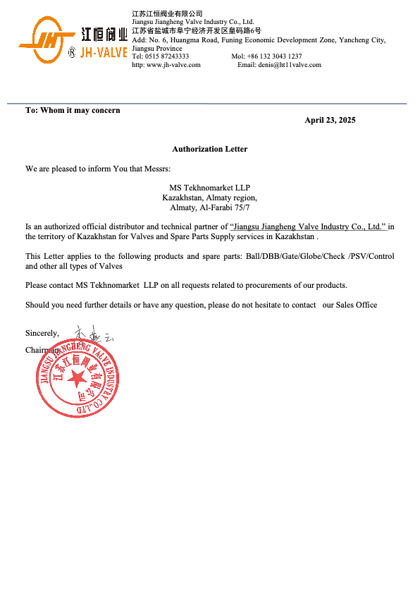
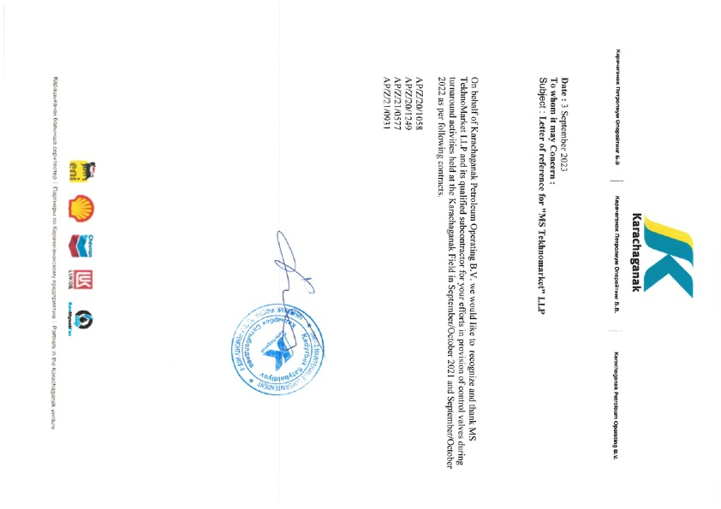
REFERENCES & AUTHORIZATIONS

Slide 9
OUR CONTACTS
CONTACT EMAIL :
sales@mstm.kz
a.kupfer@mstm.kz
rasshepko@mstm.kz
GENERAL DIRECTOR : NIKOLAY RASCHEPRKO
PHONE: + 7 701 766 79 04
Exec.Director : ALENA KUPFER
PHONE: +7 702 471 94 82
WE ARE ALWAYS AT YOUR DISPOSAL

Slide 10

THANK YOU

